Slide 1


SECURE ONLINE
AUCTION SYSTEM
STUDENT SUPERVISOR
NAME: J. GURU MONISH (191811131) NAME: N. DELUXNI
YEAR: III. DESIGNATION: ASSISTANT PROFESSOR
DEPT: CSE DEPT: CSE
COLLEGE NAME: SAVEETHA SCHOOL
OF ENGINEERING

Slide 2
ABSTRACT
Online Auction management system is a web based application which will help users to buy or sell items; they can trade anything they want by posting ad. This application will allow users to post their products for auction; bidder can register and can bid for any available product. There are some existing applications that allow users to bid but the product is not available in your local area, you cannot do inspection of the product that you are going to buy. By online Auction application users will be able to bid for products that are available in their local area.

Slide 3
INTRODUCTION
There are several different types of auctions and certain rules exist for each auction. There are variations for an auction which may include minimum price limit, maximum price limit and time limitations etc. Depending upon the auction method bidder can participate remotely or in person. Remote auction includes participating through telephone, mail, and internet. Shopping online has widely grown; online auction system is increasing rapidly. Online auction is becoming more and more popular in electronic commerce and hence it should system must increase its quality and security.

Slide 4
LITERATURE REVIEW
An auction is a market with an explicit set of rules determining resource allocation and prices on the basis of bids from market participants. Generally speaking, an auction is the standard means for performing an aggregation of supply and demand in the marketplace to effectively establish a price for a product or service. It establishes prices according to participants’ bids for buying and selling commodities, and the commodities are sold to the highest bidder. Simply stated, an auction is a method for allocating scarce goods, a method that is based upon competition between the participants. It is the purest of markets: a seller wishes to obtain as much money as possible for the commodity offered, and a buyer wants to pay as little as necessary for the same commodity.

Slide 5
EXISTING SYSTEM
From a recent study make by scientists at Carnegie Mellon University, found many fraud schemes from the historical auction data using data mining techniques and other accomplices.One of the most currently fraud schemes is that the bidders are making false identity or accounts in order to increase the sale price.
The reputation based model for sensor networks. This system works well in maintain the reputation for the nodes and also in evaluating trustworthiness. But the main drawback is that there is no effective and particular method to prevent the users from giving false identity and hence the system fails in providing a secured environment.

Slide 6
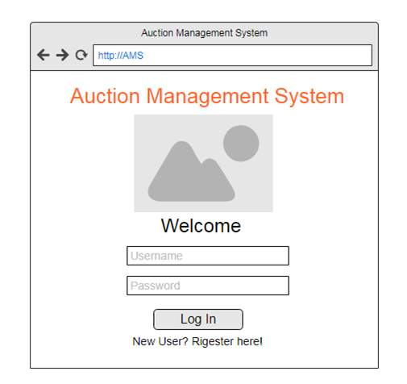
ARCHITECTURE

Slide 7
PROPOSED SYSTEM
This system will provide secure registration and profile management of the users.
Administrators would authorize the product to auction, set auction dates & minimum auction amount for that product.
Prior to each bid, the user’s mobile number and Aadhar card must be authenticated and authorized.
Users can select their interested fields for bidding and periodic Message alerts must be sent in case they have won an auction for a particular item/product.
Complete Search/Site Map of the entire site for easy access.

Slide 8
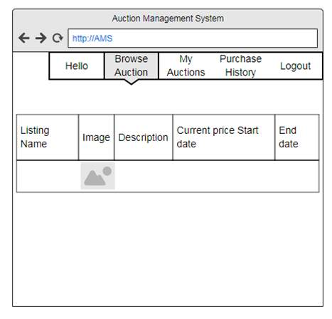
ARCHITECTURE

Slide 9
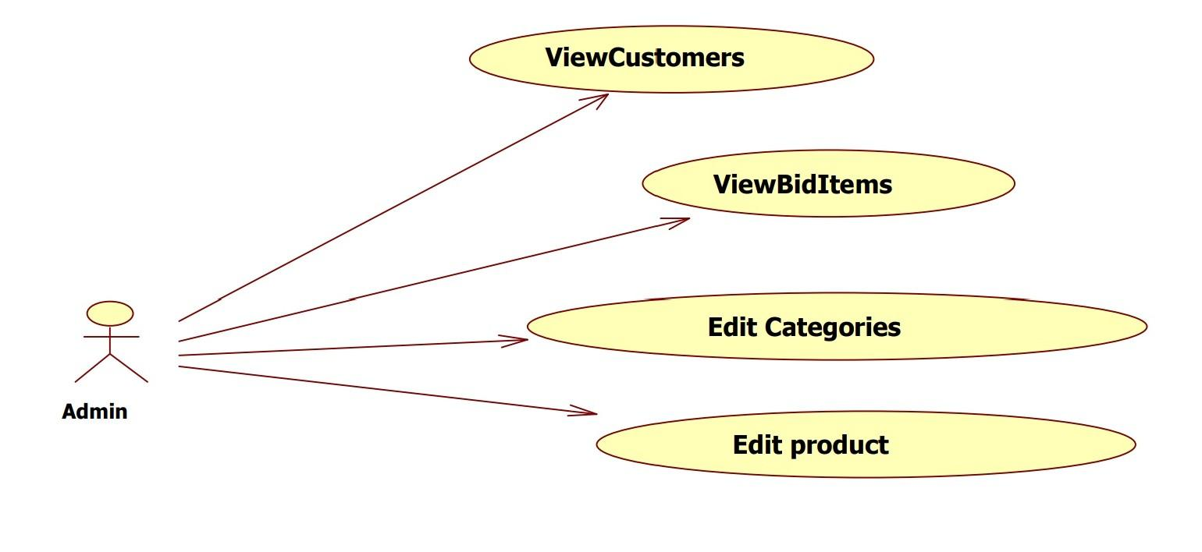
UML DIAGRAM FOR ADMIN

Slide 10
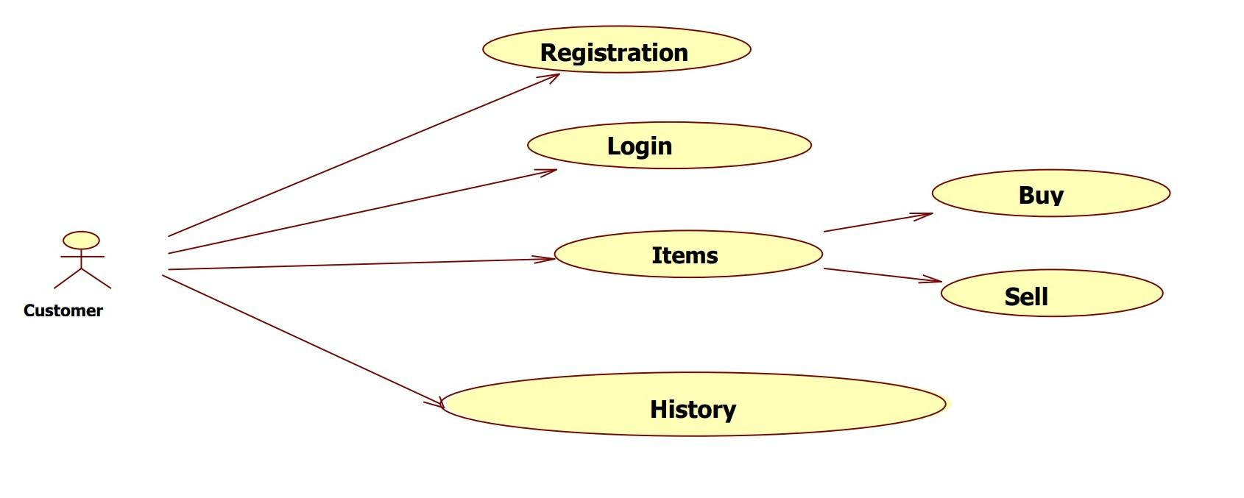
UML DIAGRAM FOR CUSTOMER

Slide 11
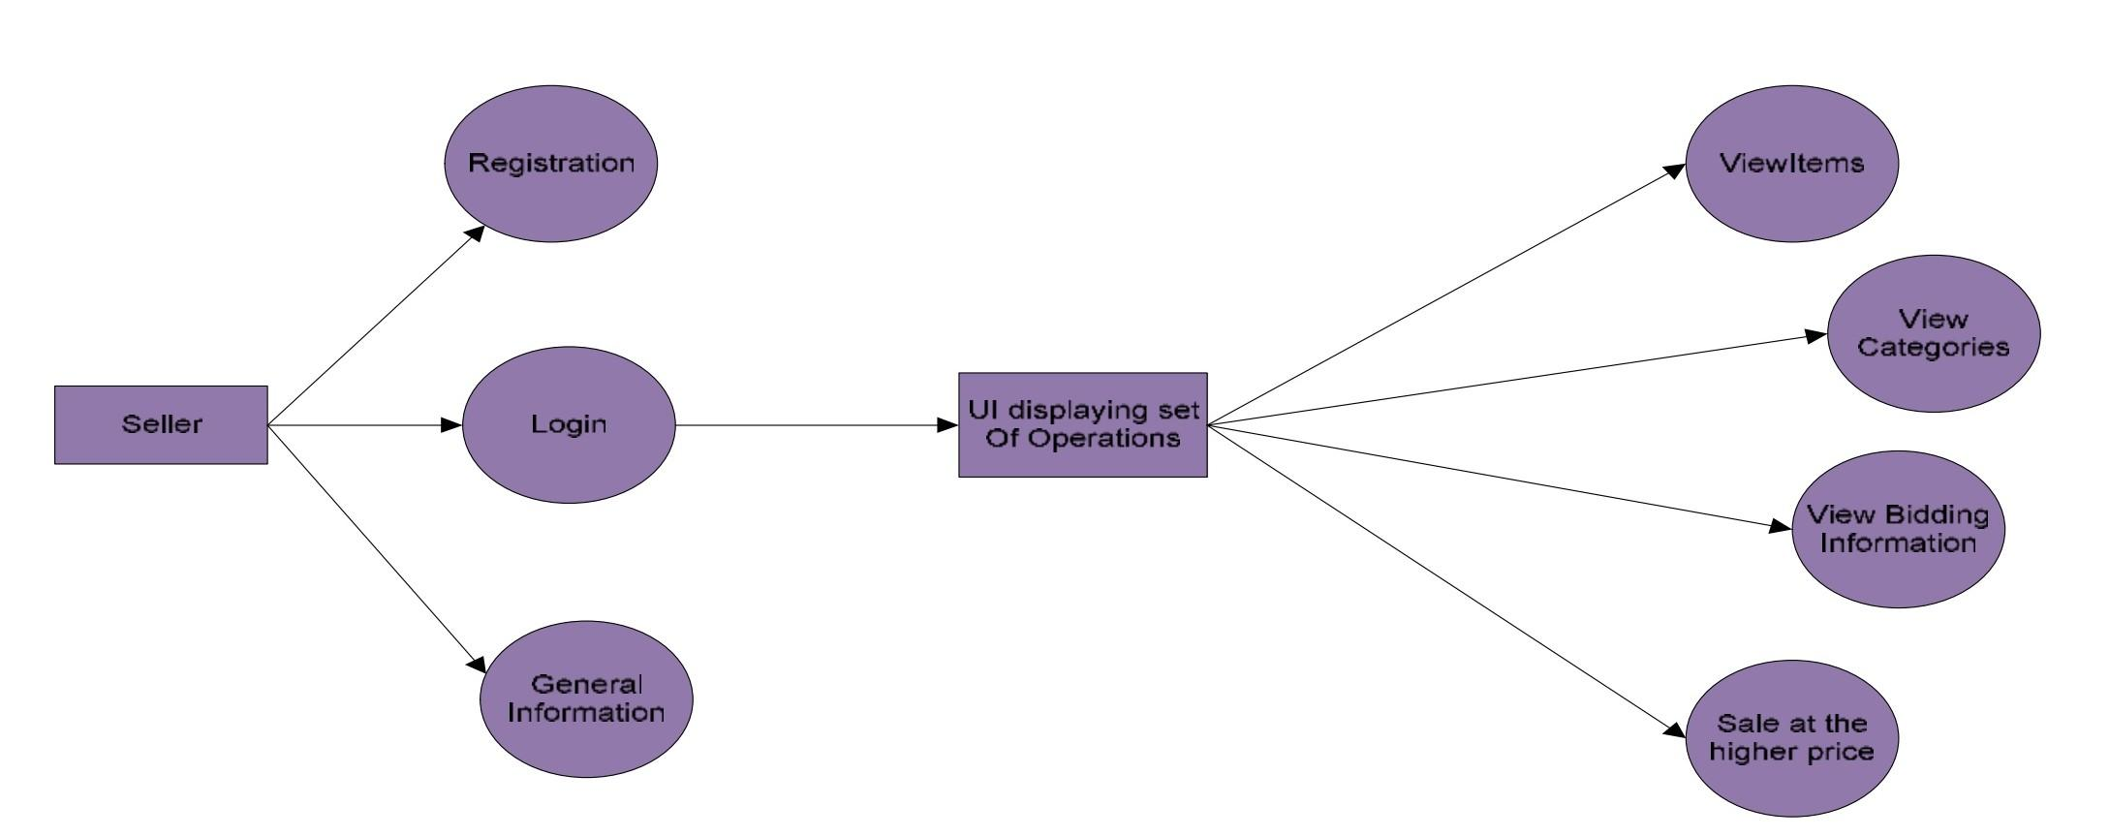
DATA FLOW DIAGRAM FOR ADMIN

Slide 12
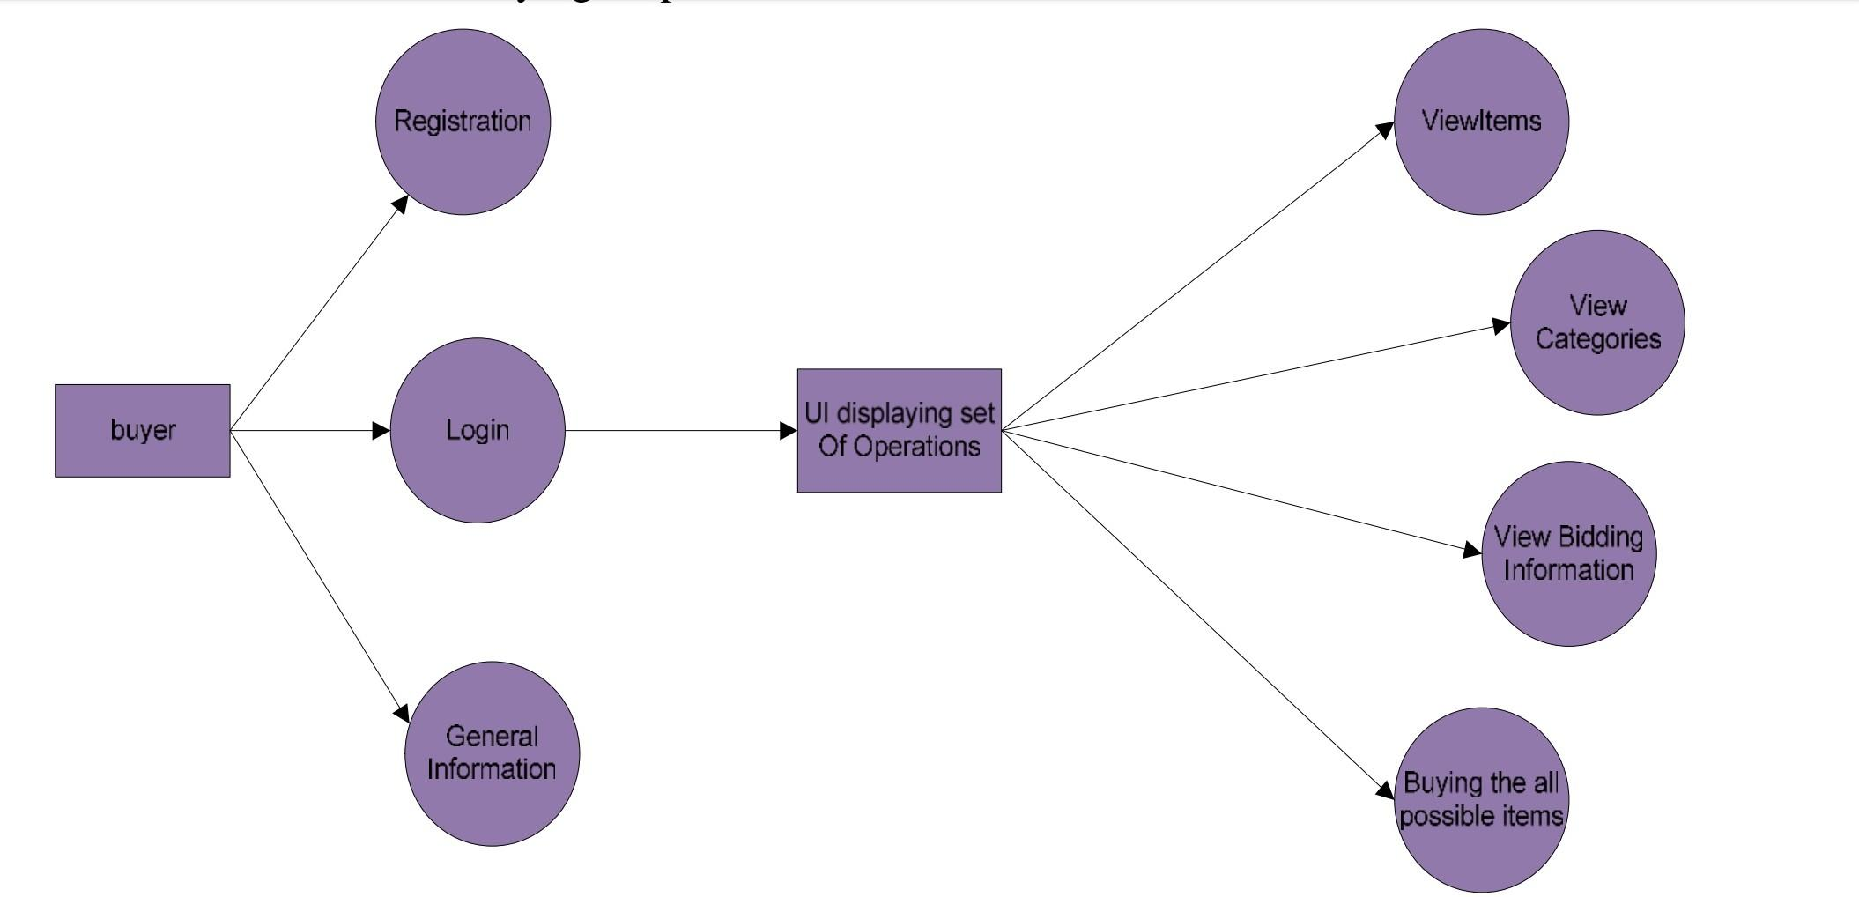
DATA FLOW DIAGRAM FOR SELLER

Slide 13
MODULE DESCRIPTION
Seller module
In this module, the seller will post the product information in which he/she wants to sell or auction the product through online. In this module the seller can post the image of the product by using capture image and all the necessary information about the product such as the product name and its description.
Buyer module
In this module, the bidder will first see which product is been posted on the app which is to be auctioned. The bidder/buyer will see all the information about the product. If the bidder is interested to buy that product then he can register for the auctioning and bid the amount. At last, at the end of the auctioning the bidder will get to know the result.
Admin module
The admin can manage the users and view the information about each item on the system. If the item was sold or reached its ending time, it will be removed from the data-base.

Slide 14
CONCLUSION
The changes in business operation, business environment, and economic condition etc. will affect consumer secure online auction portal behavior. Therefore, continuous efforts have to be devoted to studying consumer secure online auction portal 230 behavior in a dynamic way. With the knowledge of consumer secure online auction portal behavior, it is believed that e-auction will continue to grow and it will become not only an important business revenues channel, but also a part of people’s daily life.

Slide 15
REFERENCES
https://ageconsearch.umn.edu/bitstream/91423/2/PR-10-02.pdf
Chris Bates: Web Programming Building Internet Applications
Bajari, Patrick, Ali Hortacsu (2004). "Economic Insights from Internet Auctions" Journal of Economic Literature, Vol. XLII No. 2: 457-86.
www.academia.edu/9174592/ONLINE_AUCTION_MINI_PROJECT_REPORT.html
Dutta, R. and Ramamoorthy, K., International Business Machines Corp, 2009. User rating system for online auctions. U.S. Patent 7,552,081.
Gemino, A. and Parker, D. 2009. Use Case Diagrams in Support of Use Case Modeling. Journal of Database Management, 20(1), pp.1-24.

Slide 16
THANK YOU

